Slide 1
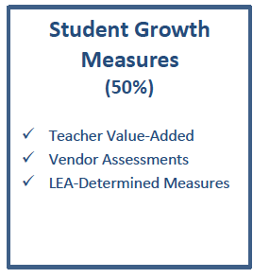
Building Student Growth Measures
HB 153 requires 50% of the teacher (and principal) evaluation framework to include measures of student growth.

Slide 2
Building Student Growth Measures

Slide 3
Building Student Growth Measures

Slide 4
Building Student Growth Measures

Slide 5
Building Student Growth Measures

Slide 6
Building Student Growth Measures
A local student growth component includes multiple measures called Student Learning Objectives (SLO’s);
Our district-level Race to the Top Assessment Team will provide leadership in the development of SLO’s;
The team will also review and recommend any vendor assessments that may support category B teachers.

