Slide 1
Professional Development Focus for 2012-2013 School Year
Project-Based Learning through Technology | Measuring Student Growth
Formative Instructional Practices | OTES/OPES “Connecting the Pieces”
September 12, 2012
Board Meeting

Slide 2
Professional Development Focus for 2012-2013 School Year
Project-Based Learning through Technology:
New assessments will ask students to solve multiple-step problems and create solutions;
Students will be expected to site their sources as they would in a research project;
Student portfolios may be an
assessment format.

Slide 3
Professional Development Focus for 2012-2013 School Year
Student Growth Measures include:
Teacher Value-Added
Vendor Assessments
LEA-Determined Measures (TBD)
Formative Instructional Practices:
Support students’ achievement in targeted areas;
Growth accelerated with these strategies;

Slide 4
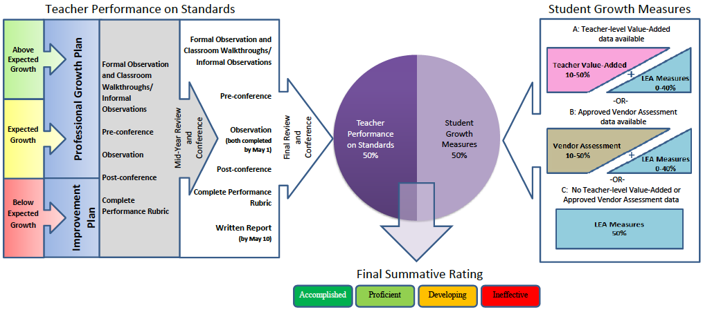
Professional Development Focus for 2012-2013 School Year
OTES/OPES training to connect all the pieces:
OTES/OPES training/connecting the pieces:

