Slide 1
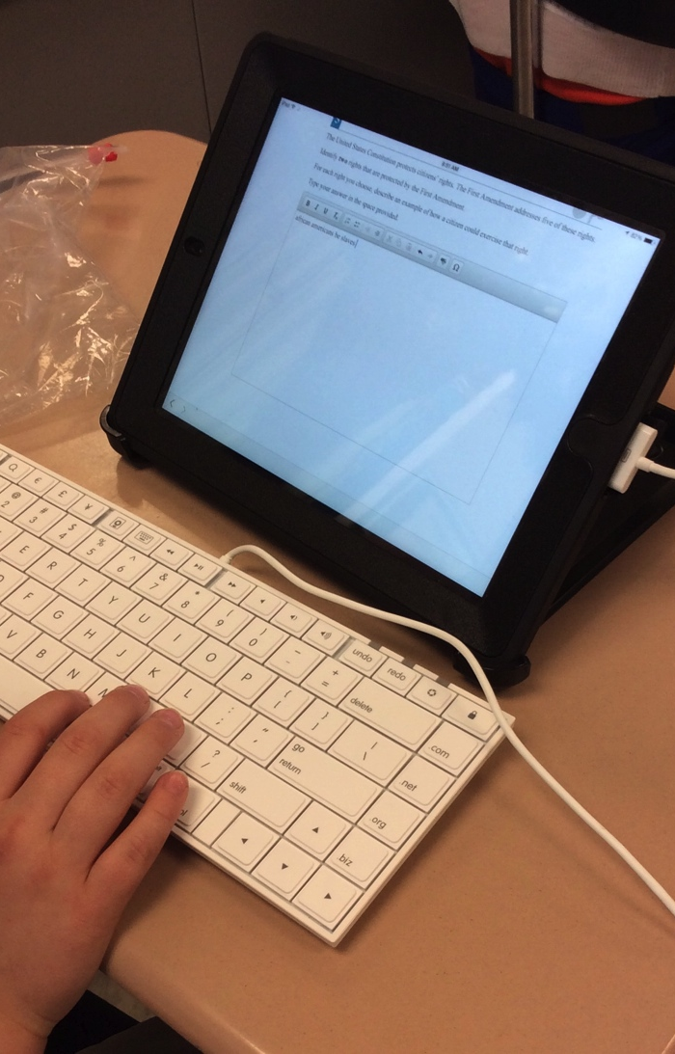
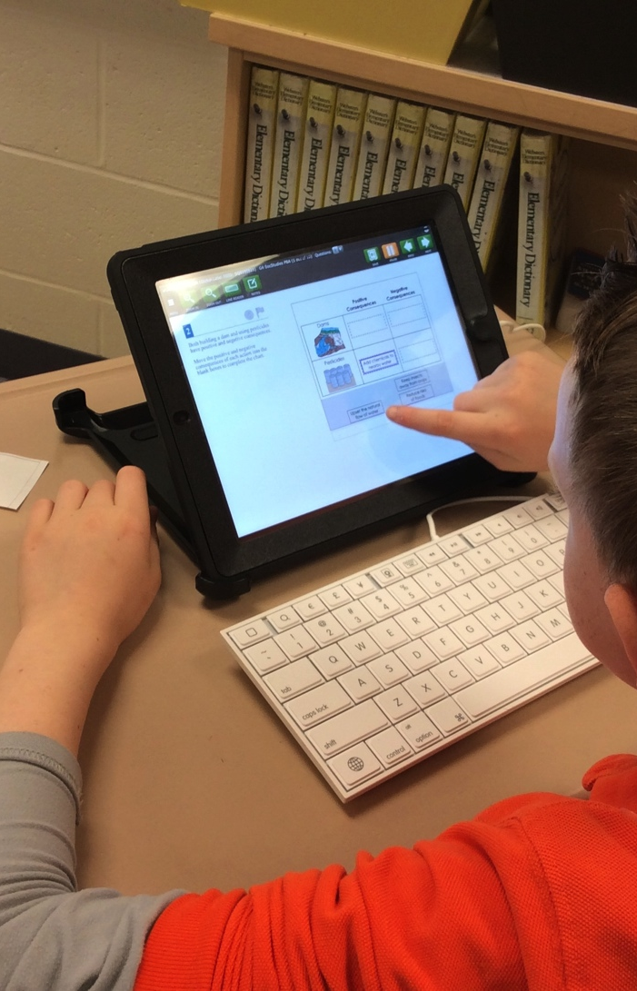
Next Steps for State Testing
Board Presentation – July 16, 2015

Slide 2
Next Steps for State Testing
Based on HB 64, ODE will no longer contract with PARCC for the annual state exams;
AIR (American Institutes for Research) will become the state test provider for students in Ohio’s public schools;

Slide 3
Next Steps for State Testing
There will be only a single test window per year;
The tests will be shorter in length;
Testing will still follow the subject specific requirements for Language Arts, Math, Science and Social Studies.

Slide 4
Next Steps for State Testing
Testing schedules remaining for 15 – 16:
OGT Fall Tests begin October 26th;
English Language Proficiency Assessment for the 21st Century (new ELPA21) begins January 11th;
Alternate Assessment for Students with Significant Cognitive Disabilities (AASCD) begins February 22nd.

